Slide 1

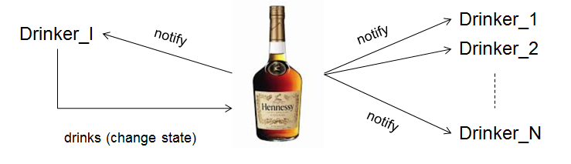
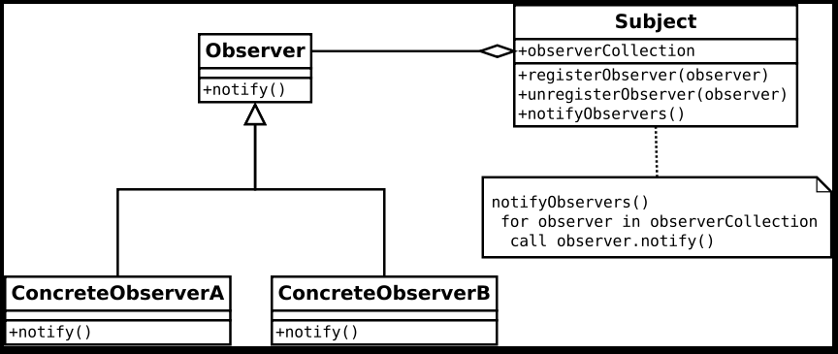
Observer pattern

Slide 2

Observer Pattern
Problem:
An unknown number of clients (observers) want to be notified, when some object changes state.
Example: Ib’s cognac bottle:

Slide 3
Observer Pattern
Drinker_1
Drinker_I
notify
notify
Drinker_2
notify
Drinker_N
drinks (change state)

Slide 4
Observer Pattern
Design Requirements:
Drinkers should be able to come and go (add and remove observers).
Drinkers should know as little as possible about how state is represented in the bottle.
The bottle should know as little as possible about the observers.
Drinkers may react differently on the notification about state change.

Slide 5
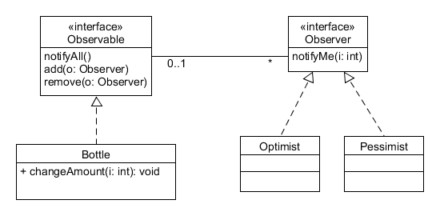
Solution: Observer Pattern

Slide 6

Observer Pattern

Slide 7
Observer Pattern (Call-back)
A number of different objects (observers) want to be notified when some given object (observable or subject) changes state.
Subject must allow observers to enroll dynamically, and subject shall have no knowledge about the observers.
This pattern is in sometimes known as call-back.

Slide 8
Observer Pattern
Example: a number of objects are interested in being told when some other object changes state.
These objects (the observers) must implement the interface Observer.
This means implementing the method notifyMe.
This method will be called when the observed object (subject) changes state.
Subject must maintain a collection of observers and be able to notify all observers (Observable).
Subject calls NotifyAll, when a change in state happens

Slide 9
Exercise
Implement this design:
Create an Eclipse project and write the two interfaces (Observer and Observable).
Implement Bottle (state could simply be implemented by an attribute holding the amount of cognac in the bottle, changeAmount() should set a new amount and notify all observes). Also Bottle should have a collection of observers (objects that implement Observer) and implement the methods inherited from Observable.
Implement two different observers as two classes that implement Observer. That is: write two different versions of reaction (the methods notifyMe(int amount) to the change in bottle state, the optimist should say something like “There is still some cognac left”, and the pessimist “There is less cognac in the bottle”.
ObserverDemos

Slide 10
Observer Pattern
Observable is sometimes called Subject
The general pattern
(from http://en.wikipedia.org/wiki/Observer_pattern#)

Slide 11
Observer Pattern
Observer Pattern is an object-oriented design that simulates void-pointers in for instance C/C++ and higher order functions in for instance Pascal and functional languages.
In C# the language construct delegate provides some of the same possibilities.
In Java and C# (and other languages supporting lambdas) some of the functionality may also be achieved using lambdas.

Slide 12
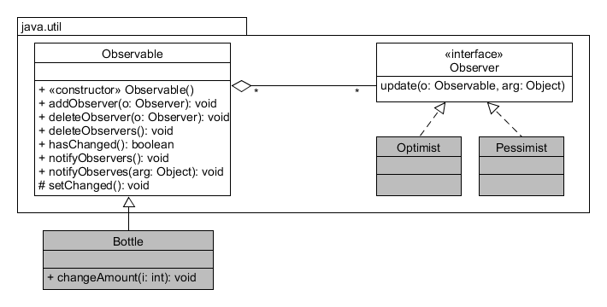
Observers in the Java std.lib
Must call setChanged() before calling notifyObserves(…)
Can pass arg:Object to notifyObservers() to inform about the new value
Will always pass the Observable object to Observable.update()

Slide 13
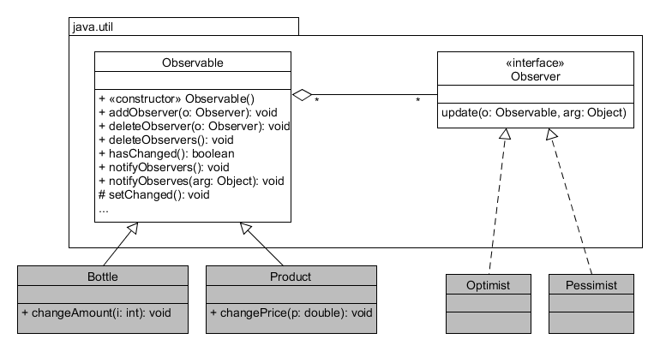
Observers in the Java std.lib
It’s possible to subscribe to multiple Observables
Unfortunately, must subclass the Observable class or implement complex adaptor/delegate pattern

Slide 14
Exercise
Add a Realist to the example. A realist will act as a pessimist, if the bottle amount is less than 35 cl. and like an optimist otherwise.
Make a method on Bottle that fills the bottle (amount = 70);
For the interested and fast:
Find the documentation for java.util.Observer and java.util.Observable. Implement the observer pattern on an example of your choice (e.g. Bottle and drinkers, or Product and Customer – customers want to subscribe to price changes).
Implement product and customer with as few attributes as possible, keep focus on the pattern.

